Slide 1




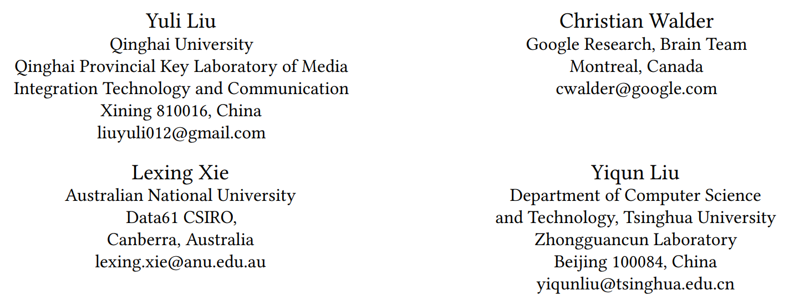





ATAI
Advanced Techniqueof Artificial Intelligence
ATAI
ChongqingUniversity _{AdvancedTechniqueof}
of Technology Artificial Intelligence
Chongqing University of
Technology
Chongqing University ^{ATAI}
_{of Technology} Advanced Techniqueof
Artificial Intelligence
Chongqing University of Technology
Chongqing University of Technology
Probabilistic Attention for Sequential Recommendation
Code: https://github.com/l-lyl/PAtt.
2024.9.19•ChongQing
—— KDD 2024
Reported by Shunan Yin
1

Slide 2

ATAI
AdvancedTechniqueof
Artificial Intelligence
ATAI
ChongqingUniversity _{AdvancedTechniqueof}
of Technology Artificial Intelligence
ChongqingUniversity of Technology
Motivation
Existing studies directly adopt the primary component of Transformer (i.e., the self-attention mechanism), without a clear explanation or tailored definition for its specific role in SR;
The predominant focus on pairwise computations overlooks the global context or relative prevalence of item pairs within the overall sequence;
Transformer primarily pursues relevance-dominated relationships, neglecting another essential objective in recommendation, i.e., diversity.

Slide 3

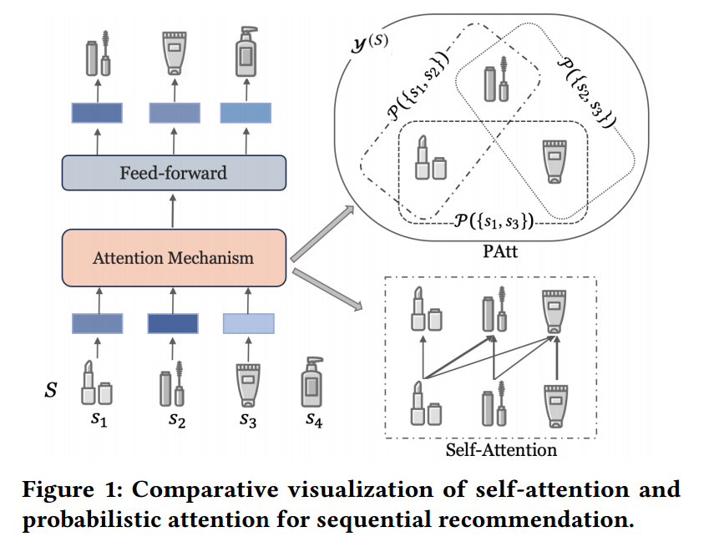
ChongqingUniversity of Technology
ATAI
AdvancedTechniqueof
Artificial Intelligence
ATAI
ChongqingUniversity _{AdvancedTechniqueof}
of Technology Artificial Intelligence
Overview

Slide 4
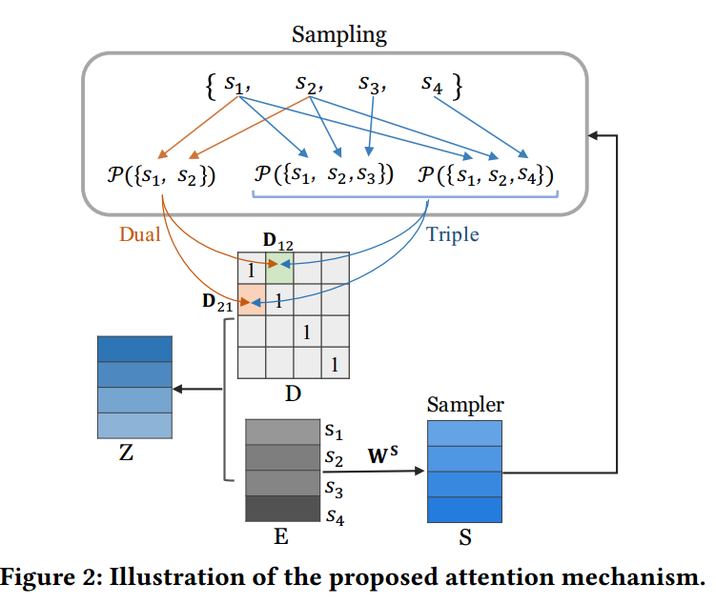
ChongqingUniversity of Technology
ATAI
AdvancedTechniqueof
Artificial Intelligence
ATAI
ChongqingUniversity _{AdvancedTechniqueof}
of Technology Artificial Intelligence
Overview

Slide 5



ChongqingUniversity of Technology
ATAI
AdvancedTechniqueof
Artificial Intelligence
ATAI
ChongqingUniversity _{AdvancedTechniqueof}
of Technology Artificial Intelligence
Method
Preliminaries

Slide 6

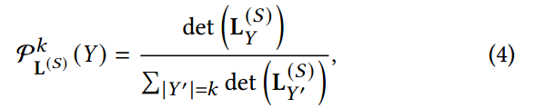





ChongqingUniversity of Technology
ATAI
AdvancedTechniqueof
Artificial Intelligence
ATAI
ChongqingUniversity _{AdvancedTechniqueof}
of Technology Artificial Intelligence
Method

Slide 7
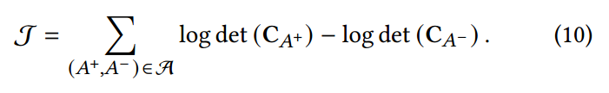

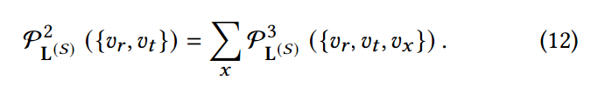
ChongqingUniversity of Technology
ATAI
AdvancedTechniqueof
Artificial Intelligence
ATAI
ChongqingUniversity _{AdvancedTechniqueof}
of Technology Artificial Intelligence
Method

Slide 8

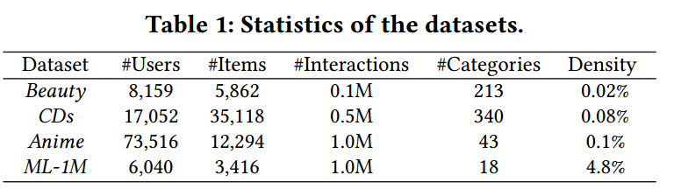
ATAI
AdvancedTechniqueof
Artificial Intelligence
ATAI
ChongqingUniversity _{AdvancedTechniqueof}
of Technology Artificial Intelligence
ChongqingUniversity of Technology
Experiments

Slide 9
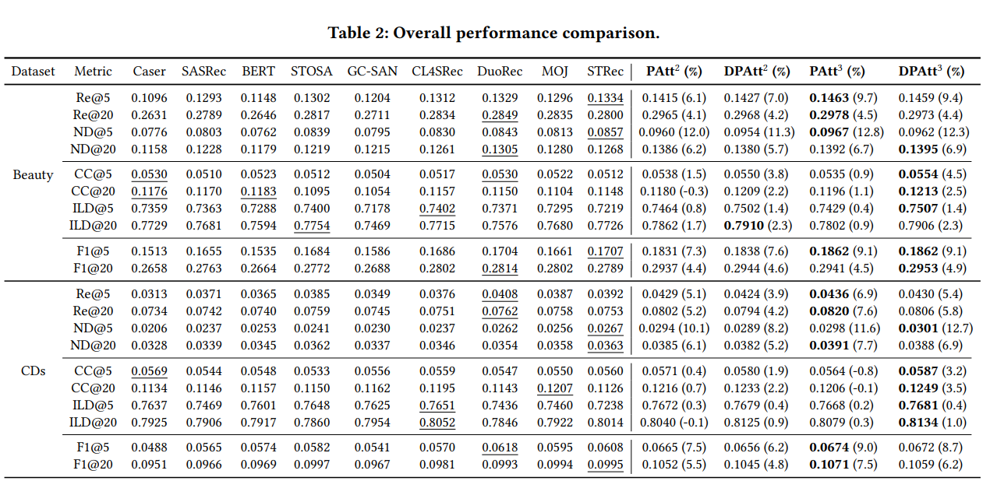
ATAI
AdvancedTechniqueof
Artificial Intelligence
ATAI
ChongqingUniversity _{AdvancedTechniqueof}
of Technology Artificial Intelligence
ChongqingUniversity of Technology
Experiments

Slide 10
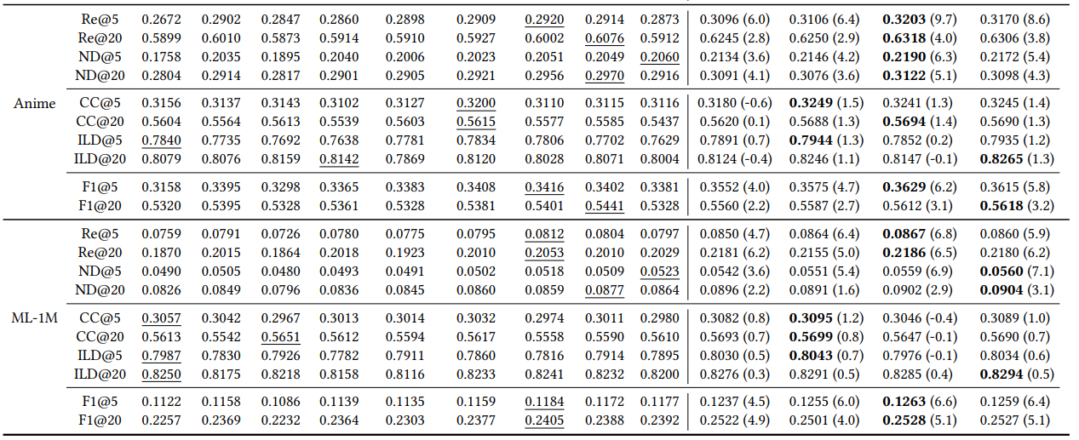
ATAI
AdvancedTechniqueof
Artificial Intelligence
ATAI
ChongqingUniversity _{AdvancedTechniqueof}
of Technology Artificial Intelligence
ChongqingUniversity of Technology
Experiments

Slide 11
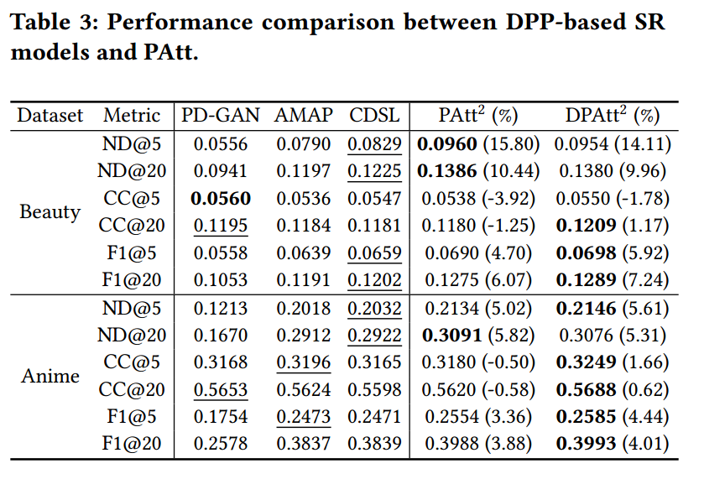
ATAI
AdvancedTechniqueof
Artificial Intelligence
ATAI
ChongqingUniversity _{AdvancedTechniqueof}
of Technology Artificial Intelligence
ChongqingUniversity of Technology
Experiments

Slide 12
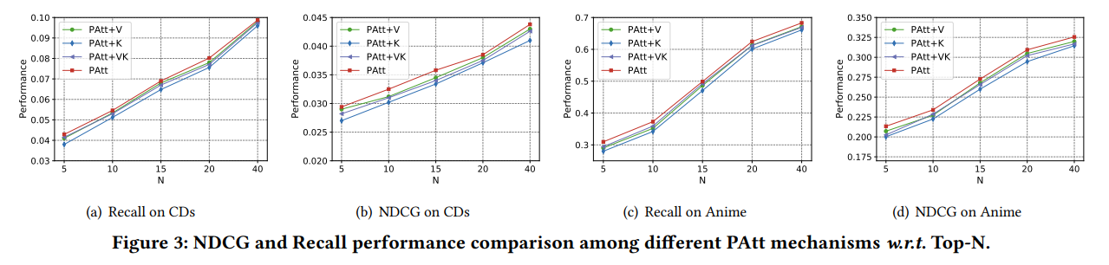
ATAI
AdvancedTechniqueof
Artificial Intelligence
ATAI
ChongqingUniversity _{AdvancedTechniqueof}
of Technology Artificial Intelligence
ChongqingUniversity of Technology
Experiments

Slide 13
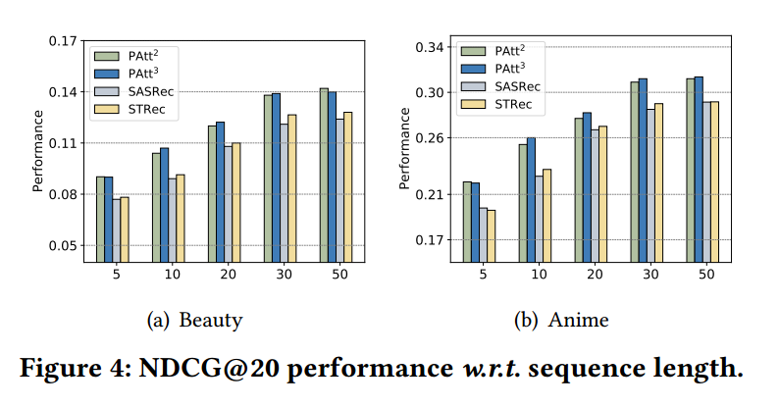
ATAI
AdvancedTechniqueof
Artificial Intelligence
ATAI
ChongqingUniversity _{AdvancedTechniqueof}
of Technology Artificial Intelligence
ChongqingUniversity of Technology
Experiments

Slide 14
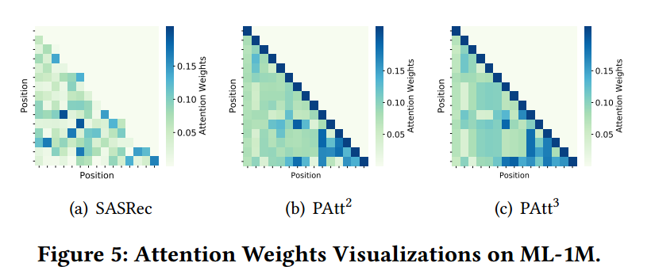
ATAI
AdvancedTechniqueof
Artificial Intelligence
ATAI
ChongqingUniversity _{AdvancedTechniqueof}
of Technology Artificial Intelligence
ChongqingUniversity of Technology
Experiments

Slide 15


ChongqingUniversity of Technology
ATAI
AdvancedTechniqueof
Artificial Intelligence
ATAI
ChongqingUniversity _{AdvancedTechniqueof}
of Technology Artificial Intelligence
Thanks!

